Slide 1
I want to experience the solidarity of allied actions that refuse fantastical narratives of commonality and hope. Determining what exactly needs to be done will involve the kind of creativity that Indigenous peoples have used to survive some of the most oppressive forms of capitalist, industrial, and colonial domination.
Kyle Whyte, “Let’s Be Honest, White Allies”
Through travelling to other people's "worlds" we discover that there are "worlds" in which those who are the victims of arrogant perception are really subjects, lively beings, resistors, constructors of visions even though in the mainstream construction they are animated only by the arrogant perceiver and are pliable, foldable, file-awayable, classifiable.
Maria Lugones, “Playfulness, World-Travelling and Loving Perception”
“If you have come to help or fix then I say thank you and ask you to go away, if you have come to stand beside me in my pain then I say welcome.”
Nura (Pitjantjatjara elder) central Australia

Slide 2
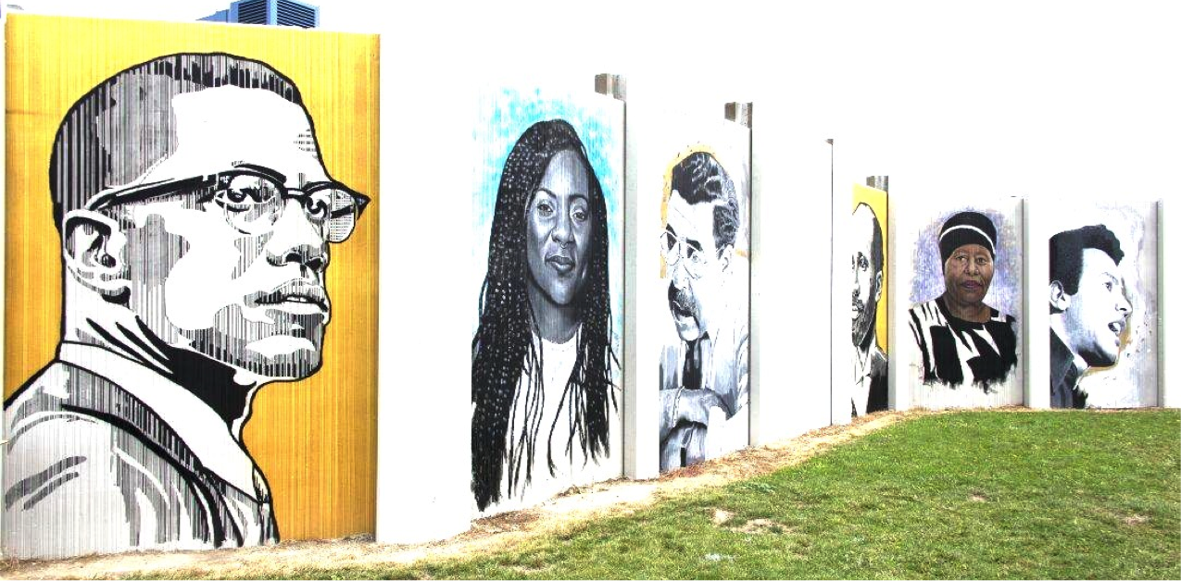
Decolonizing Service Learning
Associate Professors, Philosophy
Canisius College
Directors, Immersion East Side Program
Dr. Devonya Havis
Dr. Melissa Mosko

Slide 3
Territorial Acknowledgement
In keeping with regional protocol, we acknowledge the traditional territory of the Haudenosaunee and honor the sovereignty of the Six Nations–the Mohawk, Cayuga, Onondaga, Oneida, Seneca and Tuscarora–and their land where we are situated, where we live, and where this workshop is taking place. In this acknowledgement, our intention is to demonstrate respect for the treaties that were made on these territories and to mourn the harms – some ongoing -- of the distant and recent past.
Notes:
While our intention is to honor and bear witness, we do so imperfectly.

Slide 4
Introduction:
What Brings Us Here?

Slide 5
Why Service Learning?
Questions Open to All:
Why do we do Service Learning?
What do we want students to take away from Service Learning?
What struggles do we face meeting these goals?

Slide 6
Common Criticisms of Service Learning
Poverty Voyeurism & Exploitation
White Saviorism & Paternalism
Centers student experience over community wisdoms
Lack of intellectual, academic rigor
Methodological Confusion: is it a pedagogy or is it a text?
Our own experiences with Service Learning

Slide 7
Service Learning as Colonialism
Anibal Quijano, “coloniality of power” :
[The] specific colonial structure of power produced the specific social discriminations which later were codified as ‘racial,’ ‘ethnic’, ‘anthropological’ or ‘national’, according to the times, agents, and populations involved. These intersubjective constructions, product of Eurocentered colonial domination were even assumed to be ‘objective’, scientific’, categories, then of a historical significance. That is, as natural phenomena, not referring to the history of power. This power structure was, and still is, the framework within which... the other social relations of classes or estates [operate]. (“Coloniality and Modernity/Rationality”, in Cultural Studies, 2007)
Social and economic structures of power and control that constitute modern, liberal societies beyond formal colonialism, i.e. white supremacy as different than white privilege
Points to extant racial, political, social, and epistemic hierarchies - that appear to be natural and normal. This is the pre-formed lens through which we are trained to see the world.

Slide 8
Coloniality and Power Relations in SL
We must pay attention to the way knowledge is produced and who is allowed to produce it within the power relations that make up the practice of service learning:
Teacher-Student
Institution-Community
Suburban-Urban
Intellectual-“Native”
Theory-Practice

Slide 9
Coloniality and Knowledge Production in SL
Arrogant Perception
Orientalism
Controlling Images
→ Arrogant perceivers do not identify with the other, do not let the other rub off on them, remain untouched by their experience of the other, and feel no sense of loss in their encounter with the other. (Maria Lugones, Marilyn Frye)

Slide 10
Coloniality and Knowledge Production in SL
Arrogant Perception
Orientalism
Controlling Images
→ Orientalism involves mastery and dissemination of knowledge about the other, an ontological and epistemological distinction between the self and other, a ‘western’ style of dominating, restructuring, and having authority over the other. (Andrea Pitts)

Slide 11
Coloniality and Knowledge Production in SL
Arrogant Perception
Orientalism
Controlling Images
→ Controlling images (different than stereotypes) are created and maintained by people and institutions with social power, and are used to justify the oppression of those whose images they craft. They objectify individuals and groups through binary, oppositional thinking that is lived out via the controlling image. (Patricia Hill-Collins)
Notes:
A manifestation of systemic and structural power arrangements:
“controlling images are designed to make racism, sexism, and poverty appear to be a natural, normal and inevitable part of everyday life.”
“Even when the political and economic conditions that originally generated controlling images disappear such images prove remarkably tenacious because they… are key to maintaining interlocking systems of race, class, and gender oppression.” (Patricia Hill Collins)

Slide 12
Ethics as Responsibility to the “Other”
Arrogant Perception
Orientalism
Controlling Images
“True togetherness is not a togetherness of synthesis, but a togetherness of the face-to-face” where one encounters the other, not as content or thought but as an other to whom one must respond. It is a relation that leads one beyond one’s own being.
“The face is what one cannot kill, or at least it is that whose meaning consists in saying ‘thou shalt not kill.’”
“I am responsible for the Other without waiting for reciprocity.”
(Emmanuel Levinas)

Slide 13
Break for Questions and Comments

Slide 14
(some) Goals and Objectives for
Decolonial Service Learning
Disrupting and shifting narratives, giving a fuller account of history
Developing political literacy (Paulo Freire)
Building coalitions, not community (Kristi Dotson)
Building kinship relations (Kyle Whyte)
Notes:
Political Literacy: an awareness that one can choose the conditions of one’s life, a recognition of one’s agency to effect change
Coalitions not community: community needs shared social and genealogic knowledge; we don’t just get to be in community with people, but we can build coalitions with them
Kinship relations:
Patricia Williams, discussing practices of exclusion, “it allowed my son’s white classmates to indulged in the false luxury of a prematurely imagined community”

Slide 15
Proposing a Decolonial Praxis
Active resistance to “colonial unknowing”
Disrupting Warfare by Narrative Means
World-Traveling, Playfulness, Co-Constituting World Building
Creating space for difference, anti-assimilationist pedagogy

Slide 16
Proposing a Decolonial Praxis
Active resistance to “colonial unknowing”
Disrupting Warfare by Narrative Means
World-Traveling, Playfulness, Co-Constituting World Building
Creating space for difference, anti-assimilationist pedagogy
“Colonial unknowing” refers to “practices aimed at producing historical unknowing about originating stories in the U.S., which facilitates compliance with settler futurity.” We resist colonial unknowing by making space for narratives and wisdoms that do not serve the political status-quo. (Kristi Dotson)
→

Slide 17
Proposing a Decolonial Praxis
Active resistance to “colonial unknowing”
Disrupting Warfare by Narrative Means
World-Traveling, Playfulness, Co-Constituting World Building
Creating space for difference, anti-assimilationist pedagogy
We must deconstruct ways that meanings are constructed and/or influenced by power. Narratives are a way to recognize or map the workings of power and to examine the way the engine of United States’ political economy runs on the fuel of certain cultural politics. Narratives undergird the political economy, they continue to allow the political status quo to resist change. (Wahneema Lubiano)
→

Slide 18
Proposing a Decolonial Praxis
Active resistance to “colonial unknowing”
Disrupting Warfare by Narrative Means
World-Traveling, Playfulness, Co-Constituting World Building
Creating space for difference, anti-assimilationist pedagogy
We must travel to others’ worlds, not as a conqueror or an imperialist, but playfully, open to surprise and being affected by the other. When we travel to a world that is not our own, we see its inhabitants as subjects and agents, not as objects and victims.
(Maria Lugones)
→

Slide 19
Proposing a Decolonial Praxis
Active resistance to “colonial unknowing”
Disrupting Warfare by Narrative Means
World-Traveling, Playfulness, Co-Constituting World Building
Creating space for difference, anti-assimilationist pedagogy
“Difference must be not merely tolerated, but seen as a fund of necessary polarities between which our creativity can spark like a dialectic. Only then does the necessity for interdependency become unthreatening. Only within that interdependency of different strengths, acknowledged and equal, can the power to seek new ways of being in the world generate, as well as the courage and sustenance to act where there are no charters.” (Audre Lorde)
→

Slide 20
Towards a Decolonial Praxis: Immersion East Side
Strategic design as a seminar
Rethinking what “service” means and what counts as service
Upstream course projects
Let narratives emerge from community members, engage community as ‘teachers’
Compensating community members, being respectful guests in the community
Building a decolonial lexicon, decolonizing language
Constant reflection (academic and emotional) for students and faculty
Intellectual humility: decolonizing work is an ongoing process, is an aspirational goal

Slide 21
Institutional Commitments
Time
To build and maintain community relationships
To develop courses and programs for authentic decolonial service learning
Money
Investment in faculty
Investment in community and people who are now part of their “faculty”
Willingness to Change
Decolonial Service Learning will challenge narratives and identities
Decolonial Service Learning will force students, faculty, and institutions to engage in decolonial self re-construction
Decolonial Service Learning will not be measured by standard academic metrics

Slide 22
Without a rigorous and consistent evaluation of what kind of a future we wish to create, and a scrupulous examination of the expressions of power we choose to incorporate into all our relationships including our most private ones we are not progressing, but merely recasting our own characters in the same old weary drama.
Audre Lorde, A Burst of Light: Essays, pg. 11

Slide 23
Questions and Comments?
Contact us:
melissa.mosko@gmail.com
dnhavis@gmail.com
Find Immersion East Side on Facebook and Instagram, we promise to update more regularly if you do!

Slide 24
References
Kristi Dotson, “On the way to decolonization in a settler colony: Re-introducing Black feminist identity politics,” in AlterNative, 2013.
Paulo Freire, The Politics of Education, 1985.
Audre Lorde, A Burst Of Light: Essays, 1988.
Audre Lorde, “The Master’s Tools Will Never Dismantle the Master’s House” in Sister Outsider: Essays and Speeches, 1984.
Maria Lugones, “Playfulness, ‘World’-Travelling, and Loving Perception,” in Hypatia, 1987.
Andrea Pitts, “Decolonial Praxis and Epistemic Injustice” in The Routledge Handbook of Epistemic Injustice, 2017.
Anibal Quijano, “Coloniality and Modernity/Rationality”, in Cultural Studies, 2007.
Kyle Whyte, “White Allies, Let’s be Honest about Decolonization,” in Yes! Magazine, 2018.
Kyle Whyte, “Too late for indigenous climate justice: Ecological and relational tipping points,” in WIREs Climate Change, 2019.

